Slide 1
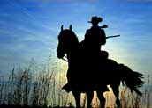
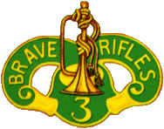
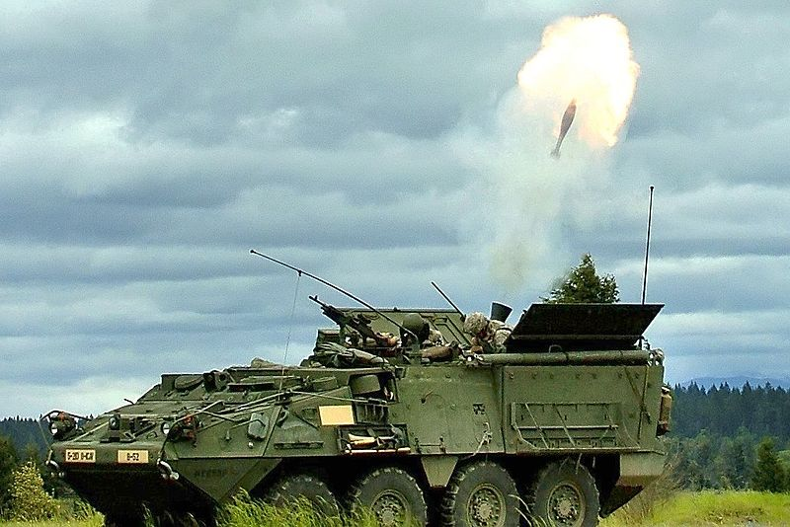
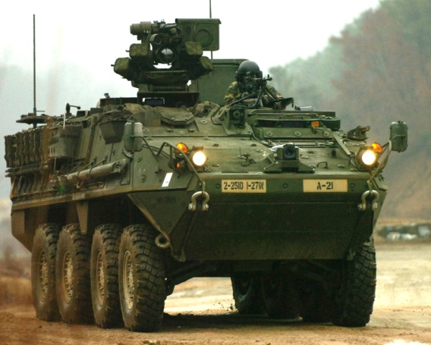
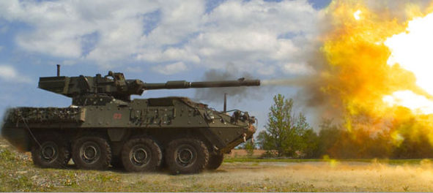
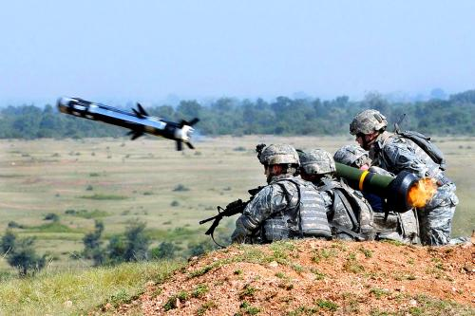
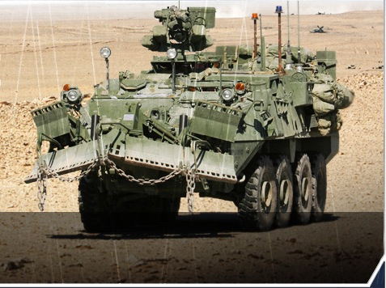
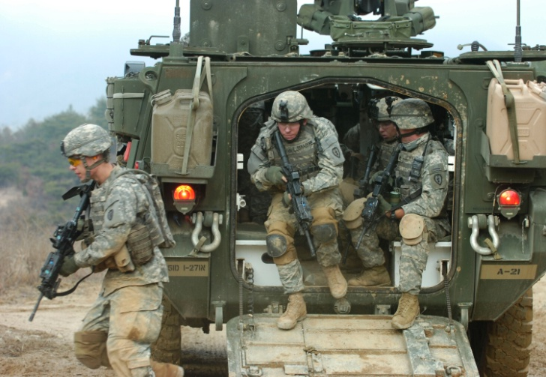
Sabre ‘Courage’ Development
Sabre 6
The Regiment of Mounted Riflemen!

Slide 2
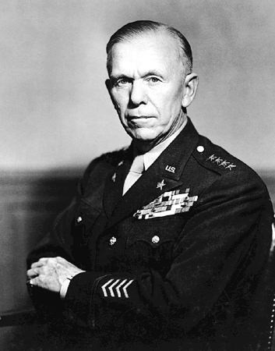
Agenda
Introduction
Purpose
References
Lesson #1
What is leadership?
Why do we develop leaders?
How do we develop leaders?
Break
My philosophy on Leader Development
Leader Development Outline
Outline
2d ¼ Fiscal Year 12 (Jan-Mar)
Break
Review Lesson #1
“He won the war.”
-Truman
“I don't want you fellows sitting around asking me what to do. I want you to tell me what to do.” GEN Marshall

Slide 3
Purpose
The purpose of this briefing is to educate 2/3 Cavalry Regiment (CR) leadership on how we will approach leader development in Fiscal Year (FY) 2012.
“These commissions (as officers) will not make you leaders, they will merely make you officers.” Author Unknown circa 1919

Slide 4
Preparation
Read:
FM 7-0 Training Units and Developing Leaders for Full Spectrum Operations (pages 2-1 through 2-8)
FM 6-22, Army Leadership (Chapters 1-3)
TRADOC Pam 525-3-0: The Army Capstone Concept (Chapter 2)
TRADOC Pam 525-3-1: The U.S. Army Operating Concept (Chapter 2 and 3)
TRADOC Pam 525-3-3: The U.S. Army Functional Concept for Mission Command (Chapter 2)
TRADOC Pam 525-3-6: The U.S. Army Functional Concept for Movement and Maneuver. (Chapter 2, Para 3-5)
Army Health Promotion, Risk Reduction, Suicide Prevention Report 2010 (Chapter 3 “The Lost Art of Leadership in Garrison”).”
Handout: Leadership in Combat: An Historical Appraisal
Handout: Auftragstaktik: Mission-Based Leadership
Bring:
74th Colonel of the Regiment’s Command Philosophy
All attendees will read and be prepared to discuss the following material.
“A leader may be the most knowledgeable person in the world, but if the players on his team cannot translate that knowledge into action, it means nothing.” Coach K.

Slide 5
References
FM 7-0, Training Units and Developing Leaders for Full Spectrum Operations
FM 6-22, Army Leadership
TRADOC Pam 525-3-0: The Army Capstone Concept
TRADOC Pam 525-3-1: The U.S. Army Operating Concept
Chapter 3 “The Lost Art of Leadership in Garrison” of the “Army Health Promotion, Risk Reduction, Suicide Prevention Report 2010”
Forces Command Training and Leader Development Guidance—Fiscal Year 2011-2012, 20 Oct 2010
III Corps FY 12 Annual Training Guidance (ATG)
Phantom 6 Command Philosophy, Imperatives
3d Cavalry Regiment FY 12 ATG
74th Colonel’s Command Philosophy
Center for Army Leadership: http://usacac.army.mil/cac2/CAL/index.asp
Use the following material to deepen your understanding of the topics presented and as starting points for self-development.
“No man is a leader until his appointment is ratified in the minds and hearts of his men.” Anonymous

Slide 6
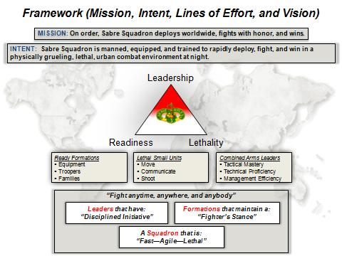
Guidance
III Corps Commander: “Commanders will implement robust leader development programs.”
74th Colonel of the Regiment: “We grow adaptive leaders. This is our #1 mission.”
Sabre 6 ‘Three Knows:’
Know your job.
Know your people.
Know, set, and enforce standards.
Our target and left and right limits.
Leaders that have:
“Disciplined Initiative”
“There are no bad troops; there are only bad leaders.” BG S.L.A Marshall

Slide 7
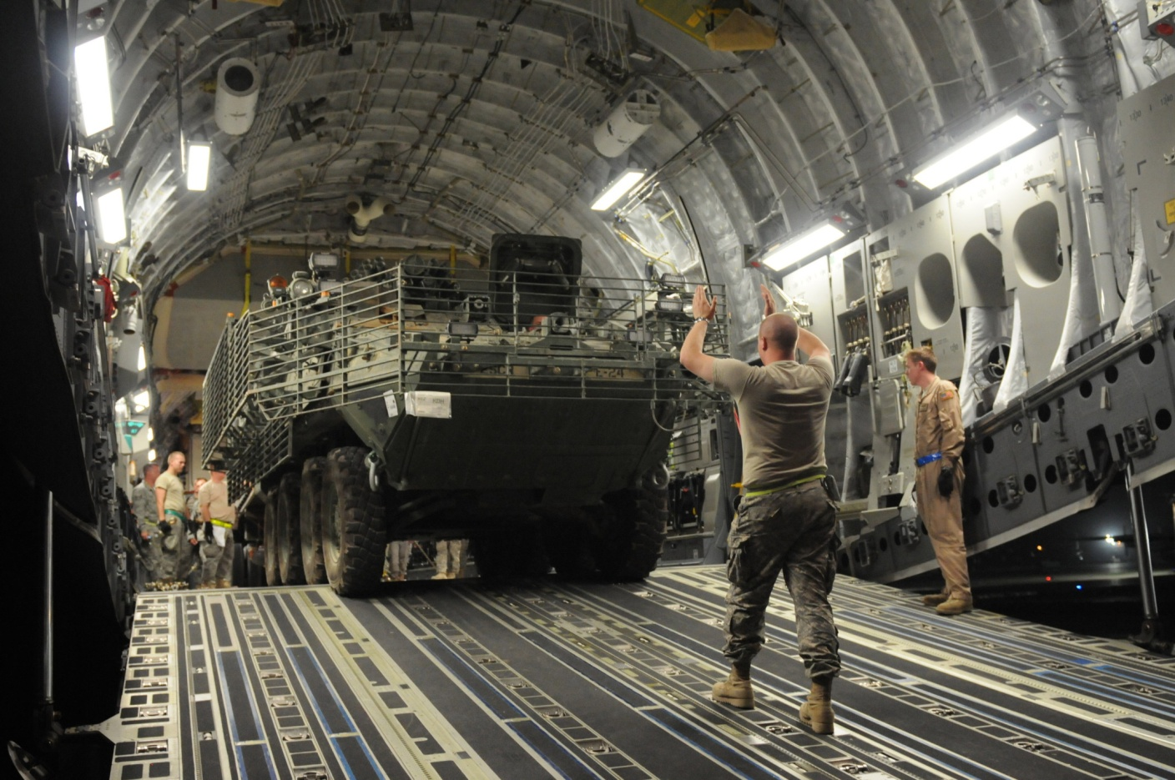
Lesson #1
Are we ready?
“Don’t begrudge the time you spend developing, coaching, and helping your people to grow so they can carry on when you’re gone. It’s one of the best signs of good leadership.” Bernard Baruch

Slide 8
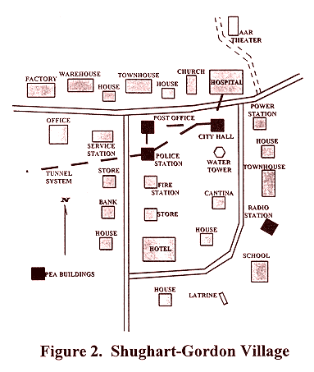
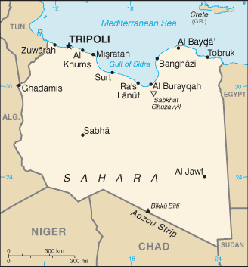
Out front and unafraid…?!
Situation: see handout
21
22
12
4
7

Slide 9
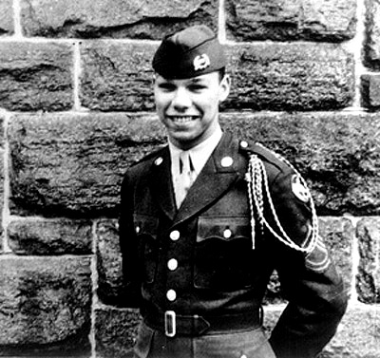
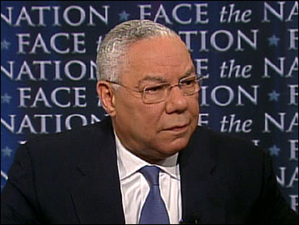
What is leadership?
Defining the Problem
"The day soldiers stop bringing you their problems is the day you have stopped leading them. They have either lost confidence that you can help them or concluded that you do not care. Either case is a failure of leadership." GEN Colin Powell

Slide 10
Leadership
Leadership is the process of influencing people by providing purpose, direction, and motivation while operating to accomplish the mission and improving the organization.
-AR 600-22
Or from a different perspective…
“Remember that leaders aren’t made leaders because they are college graduates. Leaders are invariably made leaders because they are caring and concerned about people.”
-SPC Mickey Howen
“Each in his appropriate sphere, will lead in person.” 28th Colonel of the Regiment

Slide 11
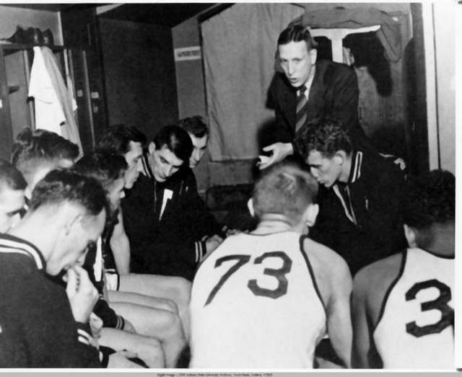
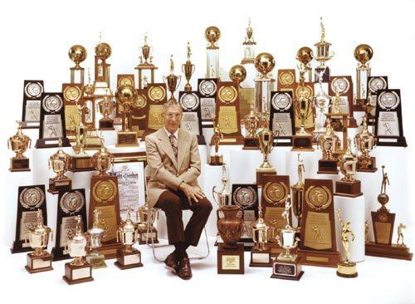
Why Do we develop leaders?
A critical question…
“Never mistake activity for achievement.” John Wooden

Slide 12
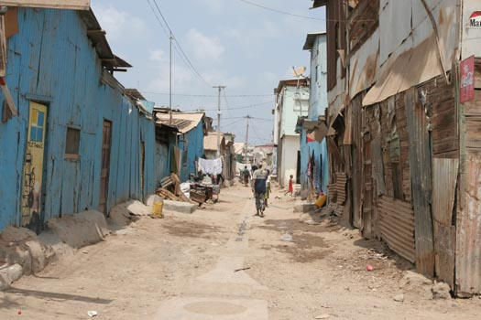
Know your job. “Leaders know the tune after two notes...”

Slide 13
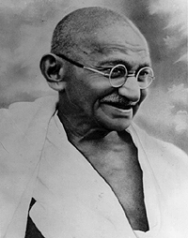
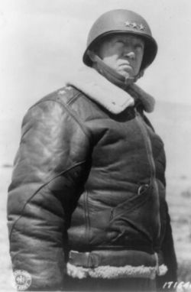
what kind of leader are we trying to develop?
A 'No' uttered from the deepest conviction is better than a 'Yes' merely uttered to please, or worse, to avoid trouble. Ghandi
“Be willing to make decisions. That's the most important quality in a good leader.” 28th
“Innovation distinguishes between a leader and a follower.” Steve Jobs
Our target?

Slide 14
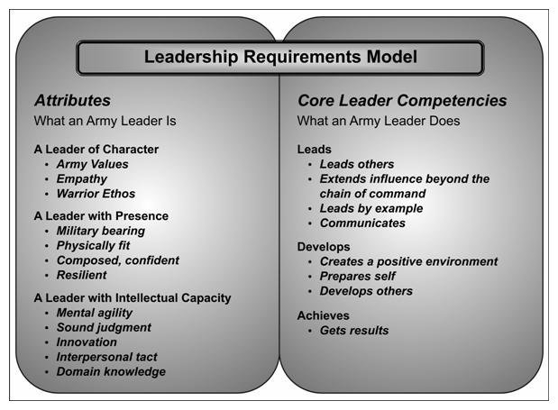
The Army’s Principles of Leader Development
Lead by example
Take responsibility for developing subordinate leaders.
Create a learning environment for subordinate leaders.
Train leaders in the art and science of mission command.
Train to develop adaptive leaders.
Train leaders to think critically and creatively.
Train your leaders to know their subordinates and their families.
AR 600-22
FM 7-0, Table 2-2

Slide 15
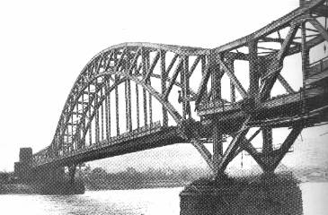
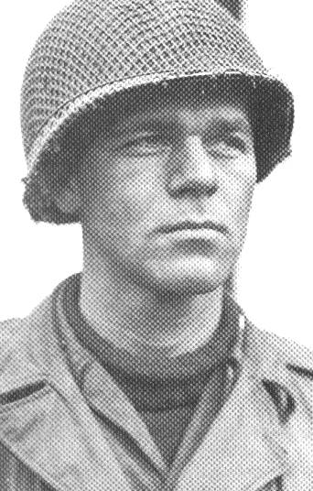
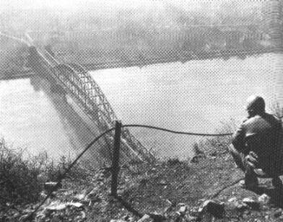
Mission Command-Auftragstaktik
To foster a mission command / mission type order based formation you must first ignore it.
Disciplined Initiative
Independent action can be the rule only if it is based on professional skill and soldiers that consider themselves (and are) experts in their fields.
“When the unexpected occurs, those waiting for new orders will lose. But those that react faster…will win.”

Slide 16
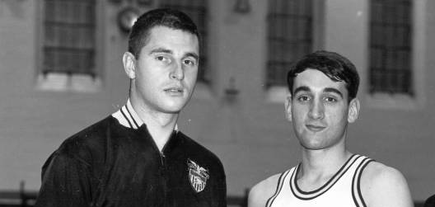
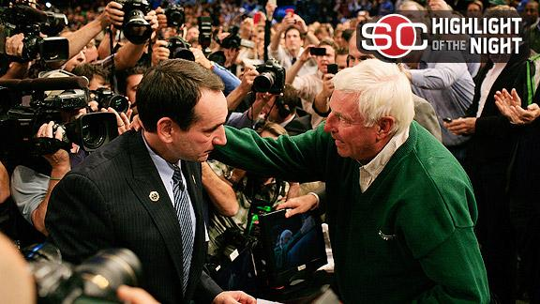
How do we develop leaders?
The critical question…
“I don’t look at myself as a basketball coach. I look at myself as a leader who happens to coach basketball.”
Coach K

Slide 17
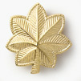
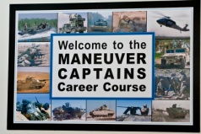
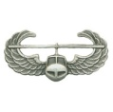
Army Basic Leader Development Model
Responsibility
LT
CPT
MAJ
LTC
Expectations
Junior Officers
Masters of craft
Value profession
Love your Soldiers
Work with NCO’s
Company Grade
Masters of your branch
Employ combined arms
Field Grade
Masters of combined arms
Familiar with Joint, Interagency, Intergovernmental, Multi-national
Assignments
Platoon Leader
Staff
Company Command
S-3 / SXO
Battalion Command
Unit Structured Leader Professional Development
Army Education
BOLC
Intermediate Level Education (ILE)
Captains Career Course (CCC)
Senior Service College (SSC)
Army Schools
“Broadening Assignments”
Self Development
Read…learn…study…reflect…think…broaden…
“I learned that good judgment comes from experience and that experience grows out of mistakes.” GEN Bradley

Slide 18
Do we do a good job of developing leaders?
“…but I think that the second lesson is that the enormous responsibility that we put on our subordinates' shoulders has to be followed with a change in the way we prepare them to accept that responsibility.”
GEN Martin Dempsey, 67th Colonel of the Regiment commenting to the U.S. Senate on leader development and lessons learned from Iraq.

Slide 19
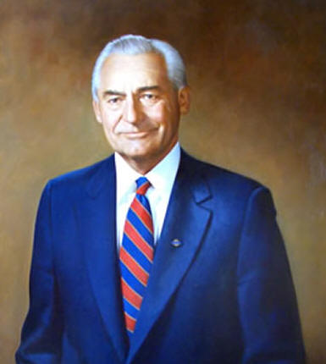
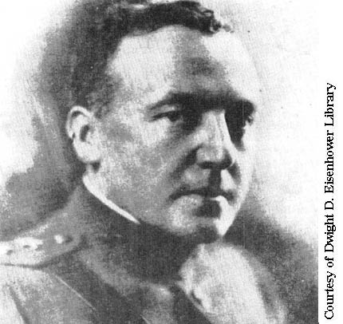
break
Who are these men?
“High expectations are the key to everything.”
“Never fight unless you have to;
Never fight alone; and
Never fight for long”

Slide 20
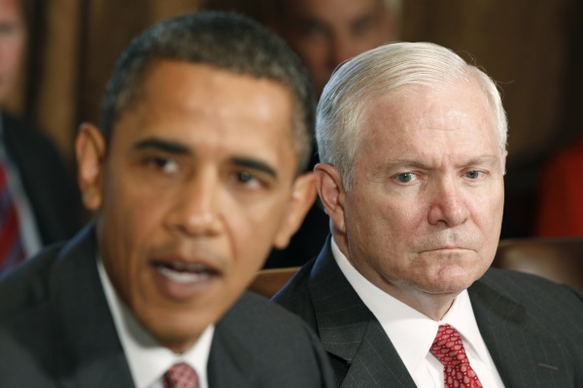
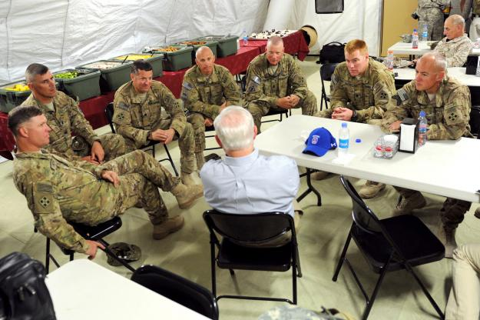
Leader development in 2/3 CR
Where we are going…
“A final quality of real leadership, I believe, is simply common decency: treating those around you – and, above all, your subordinates – with fairness and respect. An acid test of leadership is how you treat those you outrank, or as President Truman once said, “how you treat those who can’t talk back.”

Slide 21
My Philosophy on Leader Development
Professional competence
How I impact leader development…
Aim Point
Focus Groups
Structured Education
Teams in our Team
Career Mgmt.
Command Teams
Impact…
Counseling
Junior Officers
Training Focus
NCOs
Professional Schooling
Management Efficiency. Increase the leaders ability to conduct the routine tasks of the profession.
Technical Competency. Increase leaders knowledge of the science (tools, equipment, techniques) of combined arms warfare.
Tactical Competency. Increase the leaders knowledge of the art of combining movement and combined arms warfare to create maneuver.
Professionalism and Leadership. Establish a professional foundation for junior leaders for the Army as a profession and continue study on leadership.
My thought: Soldiers in combat want their leaders, above all else, to possess two basic qualities: courage and professional competence. If he has these two attributes, they will both respect him and have confidence in him. Simply put, they will follow him. However, when the leader also genuinely cares for the Soldier and his family…they fight for him. Big difference.

Slide 22
Fiscal Year 12 Leader Development
Professional competence
Focus Groups
Structured Education
Teams in our Team
Command Teams
2d ¼ Management and the Profession of Arms
3d ¼
Technical Competency
4th ¼
Tactical Competency
Junior Officers
NCOs
Leader Professional Development
“Management”
Leader Professional Development
“Live Fires”
Leader Professional Development
“Tactical SOP”
Command Teams
“Tools for the Command Team”
Command Teams
“Science of Combined Arms”
Command Teams
“Art of Combined Arms”
Junior Officers
“Professionalism”
Junior Officers
“Leadership”
Junior Officers
“Battle Drills”
NCOs
“Small Unit Ldrship”
NCOs
“Small Unit Ldrship”
NCOs
“Small Unit Ldrship”
Spur Ride
TM LFX
Squad LFX
“The kind of leadership available to an organization is a principal factor in its operation. So far as armies are concerned the quality of leadership determines their success. Indeed it often determines their survival.” Anonymous

Slide 23
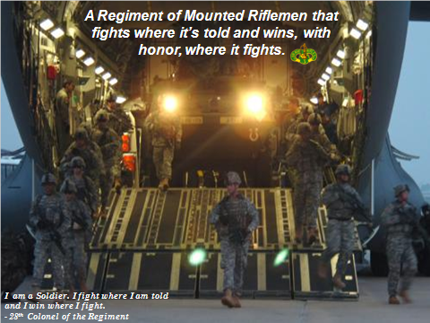
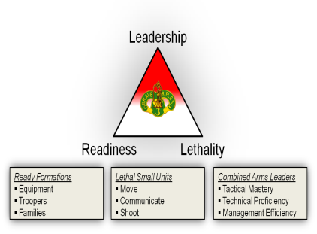
2d ¼ Leader Development
2009 Armor Conference
Question: “What do you worry about most?”
GEN Dempsey:
“No question. Leader development.
We're going to get the equipment wrong. We're going to get the guidance wrong.
We're going to get the organizations wrong. I've got to make sure you don't get it wrong.”
Leader Professional Development
“Management”
Training Mgmt
17-20 Jan
CMD Supply Discipline
30 Jan-03 Feb
Personnel Mgmt.
21-24 Feb
Maintenance Mgmt.
06-09 Mar
Garrison
SOP
Command Teams
“Tools for the Command Team”
AR 600-20
11 Jan
UCMJ
25 Jan
Chapters
8 Feb
Bars / Flags
22 Feb
HRC and Officer Management
30 Mar
Junior Officers
“Professionalism”
Army is Prof?
18Jan
Guest Spkr
1 Feb
Guest Spkr
15 Feb
Etiquette
21 Mar
NCOs
“Small Unit Ldrship”
Corrective Training
25 Jan
NCOERs
29 Feb
Counseling
28 Mar
2d ¼ Leader Development Focus: Management and the Profession of Arms
Spur Ride
3d ¼ Leader Development Focus: Technical Competency
TM LFX
4th ¼ Leader Development Focus: Tactical Competency
Squad LFX

Slide 24
2d ¼ Leader Development
Mgmt.
Technical Experts.
Tactical Experts
Mission Prep Experts.
OPD - 3
Assign Class
OPD - 2
Backbrief SCO
OPD – 1
Assign Prep
OPD - 0
Instruction
Week | 15 | 16 | 17 | 18 | 19 | 20 | 21 | 22 | 23 | 24
Assign
Backbrief
Assign Homework
Instruction
Command
J.O.
Supply
Pers.
Maint.
SPUR
Train
Supply
Pers.
Maint.
SPUR
Train
Supply
Pers.
Maint.
Train
Supply
Pers.
Maint.
1
2
3
4
1
2
3
“A pint of sweat will save a gallon of blood.” Robert D. Heinl

Slide 25
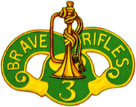
Shared Vision Statement
A Regiment of Mounted Riflemen that fights where it’s told and wins, with honor, where it fights.
Leader Development
3
Teamwork
Discipline
Combat Ready
Communication
Organizational
Values
Comprehensive Fitness

Slide 26
Framework (Mission, Intent, Lines of Effort, and Vision)
MISSION: On order, Sabre Squadron deploys worldwide, fights with honor, and wins.
INTENT: Sabre Squadron is manned, equipped, and trained to rapidly deploy, fight, and win in a physically grueling, lethal, urban combat environment at night.
Leadership
Readiness
Lethality
Ready Formations
Equipment
Troopers
Families
Lethal Small Units
Move
Communicate
Shoot
Combined Arms Leaders
Tactical Mastery
Technical Proficiency
Management Efficiency
“Fight anytime, anywhere, and anybody”
Leaders that have:
“Disciplined Initiative”
Formations that maintain a:
“Fighter’s Stance”
A Squadron that is:
“Fast—Agile—Lethal”

Slide 27
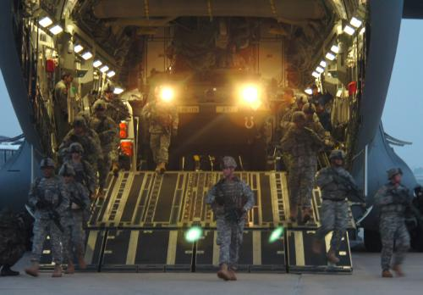
“The courage of a soldier is heightened by his knowledge of his profession.” -Vegetius 378
Leader development can’t start here, it begins now, is constant, and is the most important thing we do.

